Slide 1
10th Grade PCCR: Exploring Options
A quick review of important things!
How to prepare for exploration and opportunities

Slide 2
Making up Failed Credit
If a student receives an F in any required coursefor for graduation, they must make it up!
Options include:
Teacher Credit Recovery
Eschool Credit Recovery
Grade Replacement
Summer School
Alternative School? Referral to out alternative program is on an individual basis.
LAST RESORT!

Slide 3
Concurrent Enrollment (CE)
OR
College
Credit
Options
Live Interactive
Online options available
If you are interested in the GEC or AS Degree, please contact Kristi Nemelka, UVU advisor assigned to Wasatch High School.
Kristi Nemelka
Kristi.Nemelka@uvu.edu
801-863-6614

Slide 4
USHE Scholarships
Opportunity Scholarship
Prime Scholarship
3.3 Cumulative GPA
3 required courses, one each, in English, math, or science
AP or Concurrent Enrollment
Complete the FAFSA
Can be applied to any Utah public institution (traditional) + BYU-Provo and Westminster, Ensign College, Western Governor’s Univ. (No tech/trade schools) * award to be determined by funding
Earn a Transform Certificate
Complete FAFSA
To earn a TRANSFORM Certificate a student must complete one of the following options:
1- complete 5 C.E. courses in 5 different gen ed categories OR
2- 6 courses or 300 hours in CTE program at a Utah Technical college OR
3- complete a youth apprecticeship
Can be applied to any Utah public institution (traditional) + BYU-Provo and Westminster, Ensign College, Western Governor’s Univ. + any public Utah Technical College *one-time award, $500

Slide 5
CTE PATHWAYS
NCAA
Complete 3.0 credits in a specific CTE category
Discuss possible pathway completion with your counselor
Receive a medal and certificate at graduation
For students who want to play college sports
Must complete 16 NCAA-approved core courses
Discuss eligibility with your counselor
Register at eligibilitycenter.org

Slide 6
ESCHOOL OPTIONS (for original credit)
FREE ONLINE CLASSES
STUDENTS MAY TAKE AN ESCHOOL CLASS IN PLACE OF AN IN-PERSON CLASS or IN ADDITION TO THEIR IN-PERSON SCHEDULE
ESCHOOL CLASSES ARE DONE INDEPENDENTLY, on the student’s own time. WHS does not offer a place for students to work on eschool classes during the day.
WHS ESCHOOL IS NOT DESIGNED TO BE A COMPLETE DIPLOMA PROGRAM

Slide 7
PARENT RELEASE vs. ESCHOOL RELEASE
Parent release
No credit earned
11th/12th graders, must be on track for graduation! (9th/10th by exception)
MAY NOT BE ON CAMPUS DURING A PARENT RELEASE PERIOD!
Eschool release
No credit earned
For students enrolled in an online course to replace an in-person class.
MAY NOT BE ON CAMPUS DURING AN ESCHOOL RELEASE PERIOD.

Slide 8
Preparing yourself for exploration and opportunities

Slide 9
YouScience

Slide 10
Course Selection
How do you choose?
New classes

Slide 11
Understanding where you’re at…
Interpreting your credit evaluation

Slide 12
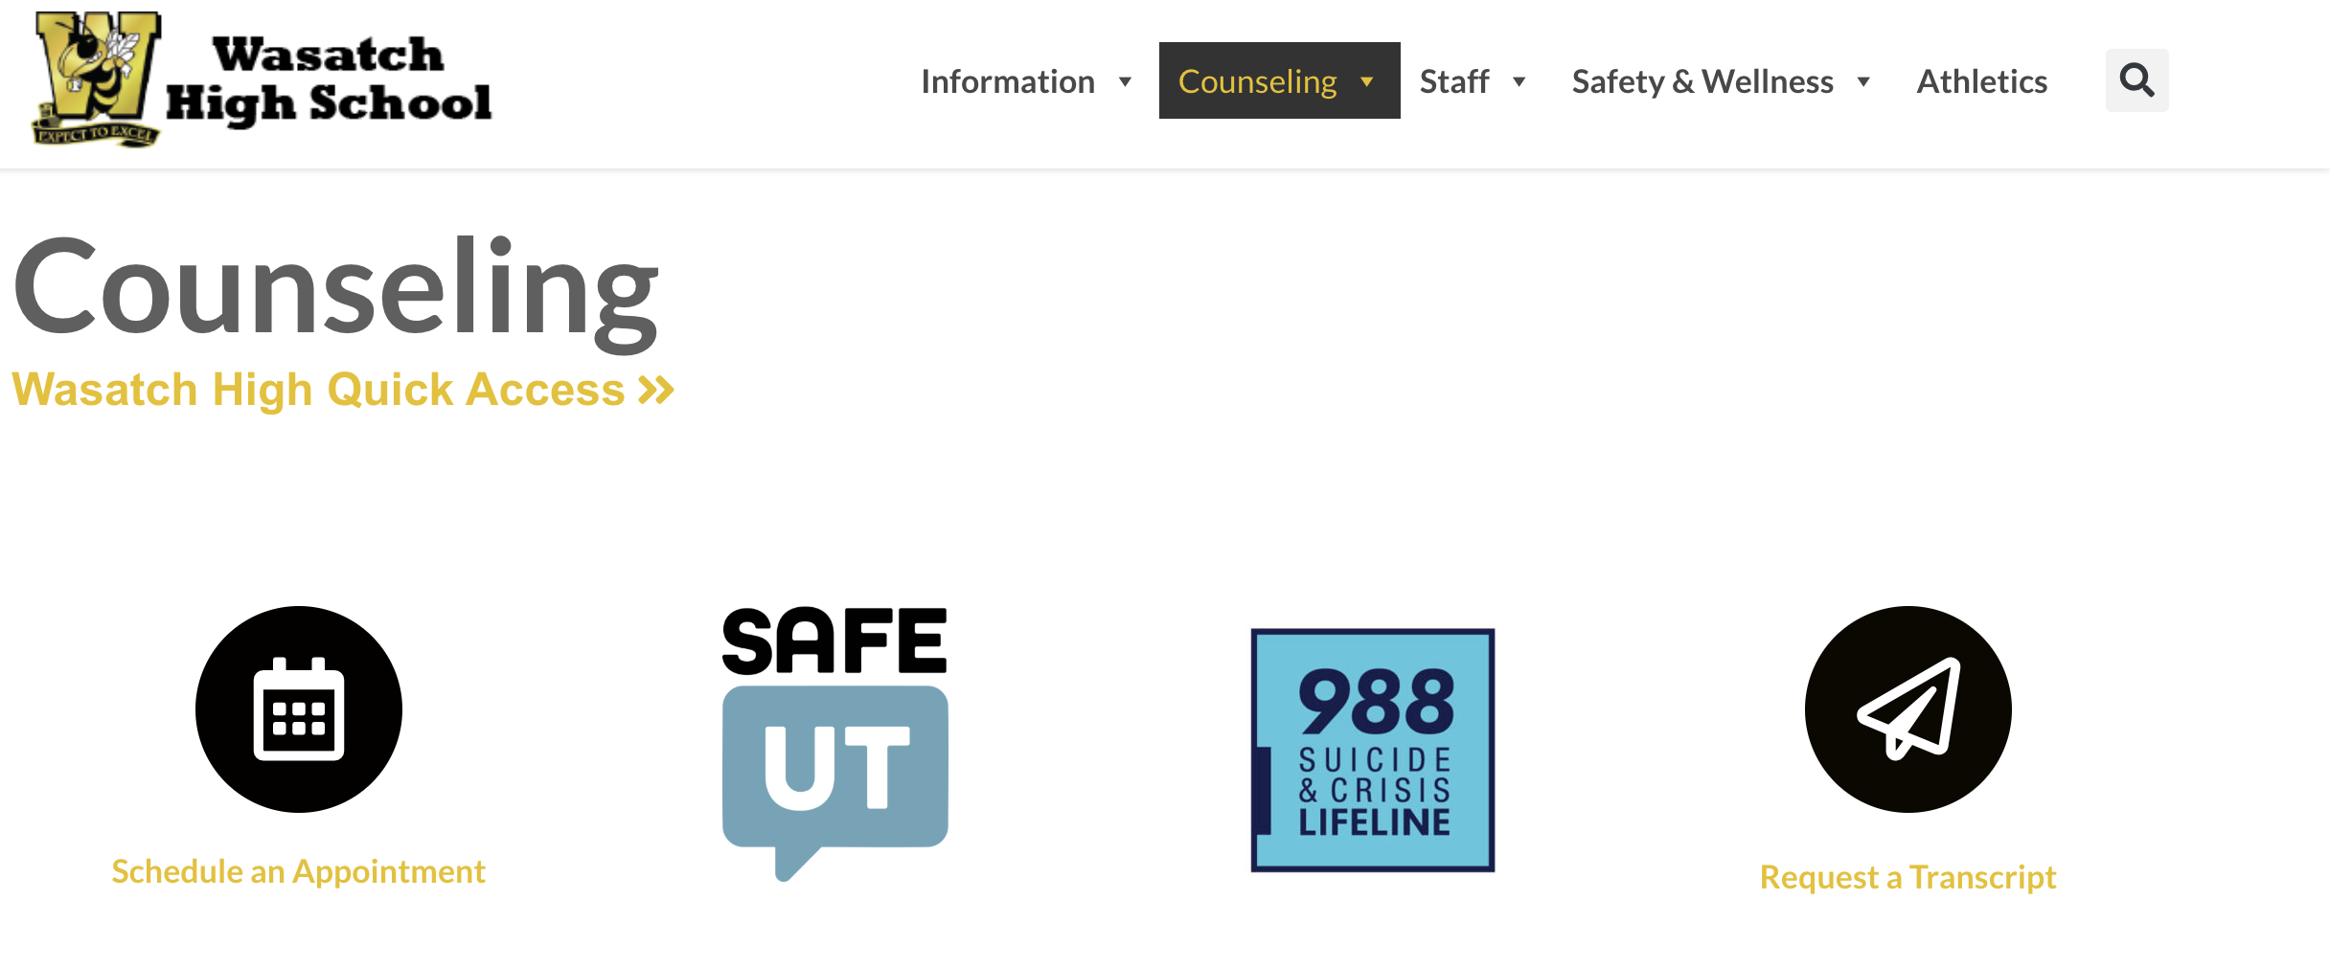
WHS Counseling Website- the hub for everything high school!
https://wasatch.edu/whs/counseling/

